Slide 1
Case-control Studies Analysis Considerations
This is the development version of the lab warm-up. Erase this text box, erase all comments, and “save as” to create the version shared with students.
Or, just move slides over to the production version one at a time as you complete changes to them.
Notes:
This week we’re discussing the analysis of data that comes from case-control studies.

Slide 2
Basic case-based case-control study design
Population of interest
Cases Identified
Exposure Measured
Calculate Odds
Compare Odds
Controls Identified
Exposure Measured
Calculate Odds
Where:
Orange = Exposed
Blue = Unexposed
Circle = No Outcome
Triangle = Outcome
Time
Notes:
As a reminder:
In this design, exposures and outcomes that we are interested in occur out in the world. Then, we come along and gather up a group of people who have already had the outcome we are interested in and then measure their history of exposures(s). Similarly, we gather up a group of people who we think are comparable to the people with the outcome in all relevant ways, but who haven’t had the outcome, and we also measure their history of exposure(s). Finally, we calculate the odds of being exposed in both groups and compare.
This is a very simplistic description, but it’s intended to just give you an intuitive feel for what we are talking about.

Slide 3
Odds ratio
 | Case | Control
Exposure + | a | b
Exposure - | c | d
Notes:
Do you remember how to calculate and interpret odds? Do you remember how to calculate and interpret an odds ratio? Let’s have a little refresher.
** Socrative 1

Slide 4
Odds ratio
 | Case | Control
Exposure + | 50 | 25
Exposure - | 100 | 100
 | Odds = 50 / 100 | Odds = ???
The odds of exposure among cases = a/c or a:c
= 50/100 or 50:100
= 0.5 or 0.5:1
= 5:10
= 1:(1 / 0.5) = 1:2
= 1:(100/50) = 1:2
Notes:
And we can express the odds in many different ways. For example, as a over c or as a to c. In this particular case, that translates to 50 over 100 or 50 to 100. Or, if we divide 50 by 100 we get 0.5, which we can also express as 0.5 to 1. In other words, for every 0.5 cases who were exposed there was one who wasn't exposed.
If we move the decimal one place to the right on both sides of our ratio, we get 5 to 10, and we can say for every 5 cases who were exposed there were 10 cases who were not exposed.
We could also divide the odds (0.5) by 1 and put them on the right hand side of the ratio. We could then say for every case who was exposed there were 2 cases who were not exposed. As you can see, we can get the same answer by dividing 100 by 50 and putting the answer on the right hand side of the ratio.
All of these are equivalent ways of expressing the odds of exposure among cases.
** Socrative 2

Slide 5
Odds ratio
 | Case | Control
Exposure + | 50 | 25
Exposure - | 100 | 100
 | Odds = 50 / 100 | Odds = 25 / 100
The odds of exposure among cases = 0.5
The odds of exposure among controls = 0.25
Notes:
Now that we've calculated the odds of exposure among cases and controls, we may want to compare them in order to say something about the association (or lack thereof) between exposure and outcome -- or being a case.

Slide 6
Association
The distribution (i.e., middle, spread, shape, proportion of people in each category) of the thing we are measuring is different, on average, in two groups.
Knowing something about X tells you something about Y.
Notes:
And remember that an association exists when the distribution of the thing we are measuring is different, on average, in two groups. Alternatively, we can say that Knowing something about x tells us something about y or helps us predict y.

Slide 7
Odds ratio
 | Case | Control
Exposure + | 50 | 25
Exposure - | 100 | 100
 | Odds = 50 / 100 | Odds = 25 / 100
The odds of exposure among cases = 0.5
The odds of exposure among controls = 0.25
Notes:
We can tell just by looking at the odds, which are 0.5 and 0.25, that they aren't the same. That is, the odds of being exposed if you are a case are greater than the odds of being exposed if you are a control. But, how much greater?

Slide 8
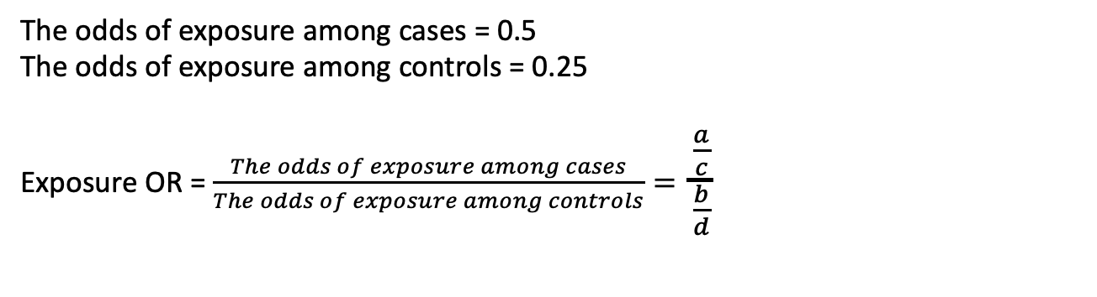
Odds ratio
 | Case | Control
Exposure + | 50 | 25
Exposure - | 100 | 100
 | Odds = 50 / 100 | Odds = 25 / 100
The odds of exposure among cases = 0.5
The odds of exposure among controls = 0.25
Exposure OR = $\frac{The odds of exposure among cases}{The odds of exposure among controls}=$ $\frac{\frac{a}{c}}{\frac{b}{d}}$
Notes:
Well, we can answer that question by calculating the ratio of the odds among cases to the odds among controls.
** Socrative 3

Slide 9
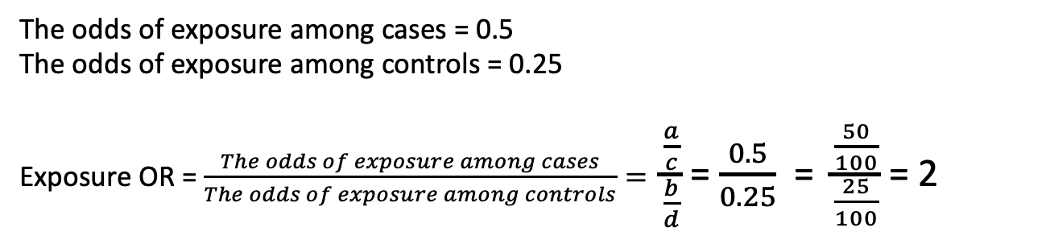
Odds ratio
 | Case | Control
Exposure + | 50 | 25
Exposure - | 100 | 100
 | Odds = 50 / 100 | Odds = 25 / 100
The odds of exposure among cases = 0.5
The odds of exposure among controls = 0.25
Exposure OR = $\frac{The odds of exposure among cases}{The odds of exposure among controls}=$ $\frac{\frac{a}{c}}{\frac{b}{d}}$ = $\frac{0.5}{0.25}$ = $\frac{\frac{50}{100}}{\frac{25}{100}}$ = 2
Notes:
So, our exposure OR is 2. And how do we interpret that?

Slide 10
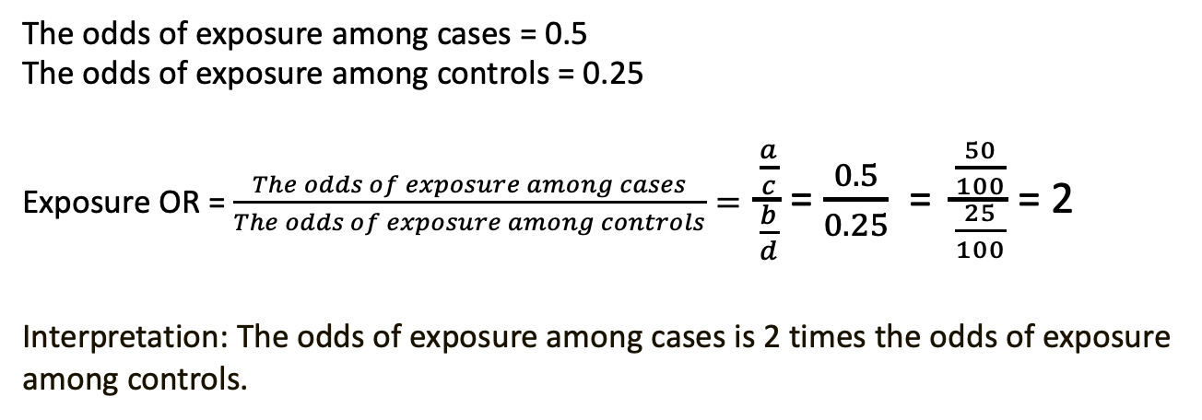
Odds ratio
 | Case | Control
Exposure + | 50 | 25
Exposure - | 100 | 100
 | Odds = 50 / 100 | Odds = 25 / 100
The odds of exposure among cases = 0.5
The odds of exposure among controls = 0.25
Exposure OR = $\frac{The odds of exposure among cases}{The odds of exposure among controls}=$ $\frac{\frac{a}{c}}{\frac{b}{d}}$ = $\frac{0.5}{0.25}$ = $\frac{\frac{50}{100}}{\frac{25}{100}}$ = 2
Interpretation: The odds of exposure among cases is 2 times the odds of exposure among controls.
Notes:
So, our exposure OR is 2. And how do we interpret that?
The odds of exposure among cases is 2 times the odds of exposure among controls.
And the odds ratio has some really convenient traits that make it an attractive measure of association when we have data from a case-control study
Can be estimated from case-based case-control study.
Can be derived from logistic regression
Can be used to approximate the relative risk under certain conditions. The relative risk is perhaps more intuitive.

Slide 11
Odds ratio
 | Case | Control
Exposure + | 50 | 25
Exposure - | 100 | 100
 | Odds = 50 / 100 | Odds = 25 / 100
Can be directly calculated from case-based case-control studies.
Can be derived from logistic regression models.
It can be used to approximate the risk ratio under certain conditions.
Notes:
And the odds ratio has some really convenient traits that make it an attractive measure of association when we have data from a case-control study
Unlike the risk ratio, the odds ratio can be directly calculated from case-based case-control study.
It can be derived from logistic regression models.
It can be used to approximate the risk ratio under certain conditions. And as we’ve said before, the risk ratio is generally considered to be a more intuitive measure of association.
Therefore, we will briefly compare the odds ratio and the risk ratio.

Slide 12
﻿Hypothetical cohort study of the 1-year incidence of acute myocardial infarction in individuals with severe systolic hypertension (≥ 180 mm Hg) and normal systolic blood pressure (< 120 mm Hg).
 | MI + | MI - | Total
Severe Hypertension | 180 | 9,820 | 10,000
Normotensive | 30 | 9,970 | 10,000
The risk of MI among severe hypertension = 180 / 10,00 = 0.018
The risk of MI among normotensive = 30 / 10,000 = 0.003
Risk ratio (RR) = 0.018 / 0.003 = 6.0
Interpretation: Participants with severe hypertension had 6 times the risk of MI over the 1-year study period compared to participants with normotensive blood pressure.
Source: Szklo, Moyses, Nieto, F. Javier. Epidemiology. Jones & Bartlett Learning.
Notes:
Sometimes, it’s helpful to start by discussing a cohort study. In the example shown here, severe hypertension and acute myocardial infarction are the exposure and the outcome of interest, respectively.
Because this is a cohort study and we know the row totals, we can calculate the risk ratio as we’ve done all semester. In this case, participants with severe hypertension had 6 times the risk of MI over the 1-year study period compared to participants with normotensive blood pressure.
For these data, the risk of myocardial infarction is relatively low for both the exposed and unexposed groups. Specifically, risk of MI is 0.018 among those with severe hypertension and 0.003 among people with normotensive blood pressure.
Therefore, the odds of developing MI will approximate the probabilities; as a result, the odds ratio of disease approximates the relative risk.
Why?
Szklo, Moyses,Nieto, F. Javier. Epidemiology (Kindle Locations 2410-2415). Jones & Bartlett Learning. Kindle Edition.

Slide 13
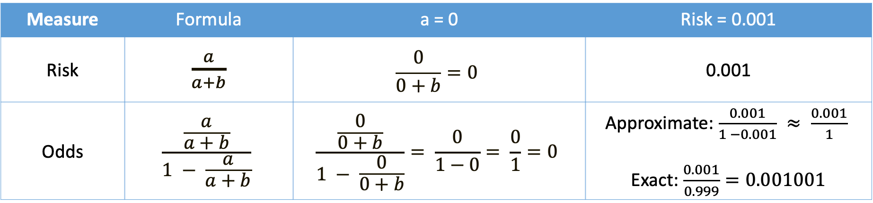
Risk and odds
 | Outcome | No Outcome | Total
Exposed | a | b | a + b
Unexposed | c | d | c + d
Measure | Formula | a = 0 | Risk = 0.001
Risk | $\frac{a}{a+b}$ | $$\frac{0}{0+b}=0$$ | 0.001
Odds | $$\frac{\frac{a}{a+b}}{1 − \frac{a}{a+b}}$$ | $$\frac{\frac{0}{0+b}}{1 − \frac{0}{0+b}}= \frac{0}{1−0}= \frac{0}{1}=0$$ | Approximate: $\frac{0.001}{1 −0.001} ≈ \frac{0.001}{1}$ Exact: $\frac{0.001}{0.999}=0.001001$
Notes:
Because, the odds is a calculated as the risk over 1 minus the risk. When the risk is really low, then 1 – minus the risk is very close to 1, and any number divided by 1 is that number. So, you basically end up with the risk divided by 1, which is just the risk.
As an extreme example, if a is 0 then the risk in the exposed is 0. Likewise, the odds in the exposed is 0 divided by 1 minus zero, which is 0 divided by 1, which is also zero. In this case the odds equal the risk.
Now, as a slightly less extreme example, let’s imagine the risk is 0.001 or 1 in 1,000. In this case, the denominator is almost 1 (0.999 to be exact) and therefore, the odds are almost identical to the risk.
So, the smaller the risk, the closer 1 minus the risk is to one, and therefore, the better the risk and the odds approximate each other. As the outcome becomes less rare, the OR will generally become increasingly more extreme than the RR.

Slide 14
Odds ratio example
 | MI + | MI - | Total
Severe Hypertension | 180 | 9,820 | 10,000
Normotensive | 30 | 9,970 | 10,000
The odds of severe hypertension among cases = 180 / 30 = 6
The odds of severe hypertension among controls = 9,820 / 9,970 = 0.985
Exposure odds ratio (OR) = 6 / 0.985 = 6.09
Source: Szklo, Moyses, Nieto, F. Javier. Epidemiology. Jones & Bartlett Learning.
Notes:
And although we would typically calculate the risk ratio as our measure of association from cohort data like this, we can also calculate the odds ratio. In this case, the exposure odds ratio is 6.09 – similar to the risk ratio.
And how would we interpret that odds ratio?

Slide 15
Odds ratio example
 | MI + | MI - | Total
Severe Hypertension | 180 | 9,820 | 10,000
Normotensive | 30 | 9,970 | 10,000
The odds of severe hypertension among cases = 180 / 30 = 6
The odds of severe hypertension among controls = 9,820 / 9,970 = 0.985
Exposure odds ratio (OR) = 6 / 0.985 = 6.09
Interpretation: Participants with MI had 6.09 times the odds of severe hypertension compared to participants who did not have an MI over the 1-year study period.
Source: Szklo, Moyses, Nieto, F. Javier. Epidemiology. Jones & Bartlett Learning.
Notes:
We could say participants with MI had 6.09 times the odds of severe hypertension compared to participants who did not have an MI over the 1-year study period.
Ok, great. The odds ratio approximates the risk ratio. Why not just always calculate the risk ratio then?
Again, we know the total number of participants who were exposed and who were unexposed in this cohort study data – 10,000 each -- but in a typical case-based case-control study we don’t have that information. That’s the basic reason we can’t just keep calculating the more intuitive risk ratio.

Slide 16
10% of controls
 | MI + | MI - | Total
Severe Hypertension | 180 | 982 | ??
Normotensive | 30 | 997 | ??
The odds of severe hypertension among cases = 180 / 30 = 6
The odds of severe hypertension among controls = 982 / 997 = 0.985
Exposure odds ratio (OR) = 6 / 0.985 = 6.09
Interpretation: Participants with MI had 6.09 times the odds of severe hypertension compared to participants who did not have an MI over the 1-year study period.
Source: Szklo, Moyses, Nieto, F. Javier. Epidemiology. Jones & Bartlett Learning.
Notes:
For example, what if we our control group only consisted of a 10,000 sample of the people from our cohort (real or hypothetical) who did not have MI. In this case, we won’t know the total number of participants who were exposed and who were unexposed in the cohort. However, as you can see, this doesn’t impact our odds ratio estimate at all. We still find that participants with MI had 6.09 times the odds of severe hypertension compared to participants who did not have an MI over the 1-year study period.

Slide 17
Odds ratio example
 | MI + | MI - | Total
Severe Hypertension | 180 | 9,820 | ??
Normotensive | 30 | 9,970 | ??
The odds of MI among among severe hypertension = 180 / 9,820 = 0.018
The odds of MI among Normotensive = 30 / 9,970 = 0.003
Disease odds ratio (OR) = 0.018 / 0.003 = 6.09
Interpretation: Participants with severe hypertension had 6.09 times the odds of MI compared to participants with normotensive blood pressure over the 1-year study period.
Source: Szklo, Moyses, Nieto, F. Javier. Epidemiology. Jones & Bartlett Learning.
Notes:
It also turns about that the exposure odds ratio and disease odds ratio will always match as we can see here.
In other words, we can now say that participants with severe hypertension had 6.09 times the odds of MI compared to participants with normotensive blood pressure over the 1-year study period.
This second interpretation is generally the one of greater interest.

Slide 18
10% of controls
 | MI + | MI - | Total
Severe Hypertension | 180 | 982 | ??
Normotensive | 30 | 997 | ??
The odds of MI among among severe hypertension = 180 / 982 = 0.183
The odds of MI among normotensive = 30 / 997 = 0.030
Disease odds ratio (OR) = 0.183 / 0.030 = 6.09
Interpretation: Participants with severe hypertension had 6.09 times the odds of MI compared to participants with normotensive blood pressure over the 1-year study period.
Source: Szklo, Moyses, Nieto, F. Javier. Epidemiology. Jones & Bartlett Learning.
Notes:
And just so you believe me. We will do the calculation again using a 10% sample of controls.
As long as the proportion of exposed and unexposed remains constant (sampling error aside), the OR remains constant. And, as long as the outcome is rare, the OR approximates the risk.
Speaking of sampling error.

Slide 19
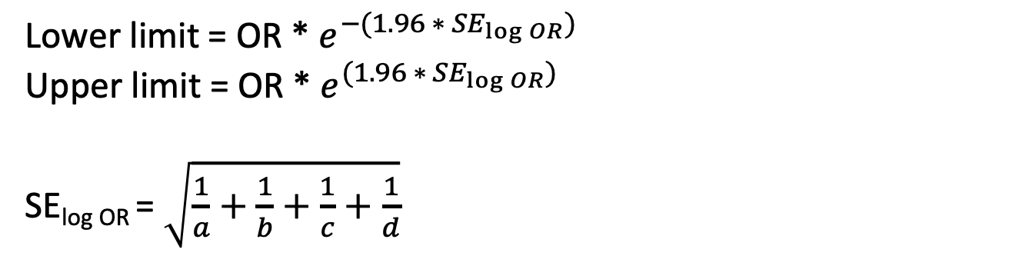
95% confidence interval (CI) for odds ratio (OR)
 | Case | Control
Exposure + | a | b
Exposure - | c | d
Lower limit = OR * $e^{−(1.96 ∗ {SE}_{\log{OR}})}$
Upper limit = OR * $e^{(1.96 ∗ {SE}_{\log{OR}})}$
SE_{log OR} = $\sqrt{\frac{1}{a}+\frac{1}{b}+\frac{1}{c}+\frac{1}{d}}$
Notes:
One commonly used way of quantifying the amount of sampling error in our odds ratio estimate is to calculate a 95% confidence interval around it. This slide presents the formula for doing so.

Slide 20
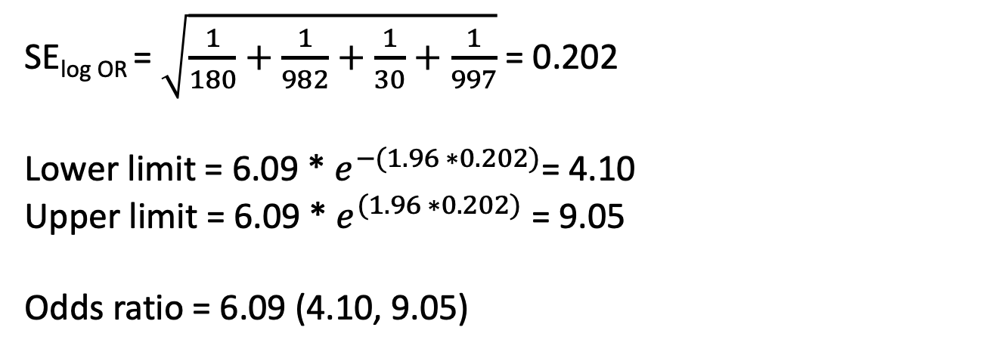
95% confidence interval (CI) for odds ratio (OR)
 | Case | Control
Exposure + | 180 | 982
Exposure - | 30 | 997
SE_{log OR} = $\sqrt{\frac{1}{180}+\frac{1}{982}+\frac{1}{30}+\frac{1}{997}}$ = 0.202
Lower limit = 6.09 * $e^{−(1.96 ∗0.202)}$= 4.10
Upper limit = 6.09 * $e^{(1.96 ∗0.202)}$ = 9.05
Odds ratio = 6.09 (4.10, 9.05)
Source: Szklo, Moyses, Nieto, F. Javier. Epidemiology. Jones & Bartlett Learning.
Notes:
In this case, we could say that the point estimate for the odds ratio is 6.09 with a 95% confidence interval that spans from 4.10 to 9.05.
And how do we interpret that confidence interval?

Slide 21
95% confidence interval (CI) for odds ratio (OR)
 | Case | Control
Exposure + | 180 | 982
Exposure - | 30 | 997
Odds ratio = 6.09 (4.10, 9.05)
"Over infinite repeated sampling, and in the absence of selection, information, and confounding bias, the 95%l confidence interval will include the true value in 95% of the samples for which it is calculated.” (Whitcomb, 2020)
The confidence interval, however, indicate that these data are compatible with a strong association between the exposure and the outcome — assuming that the statistical model used to construct the interval is correct and free of selection, information, and confounding bias.
Notes:
Technically we can say…
"Over infinite repeated sampling, and in the absence of selection, information, and confounding bias, the 95%l confidence interval will include the true value in 95% of the samples for which it is calculated."
Naimi AI, Whitcomb BW. Can Confidence Intervals be Interpreted? Am J Epidemiol. Published online January 29, 2020. doi:10.1093/aje/kwaa004 (Links to an external site.)
What’s the problem with this interpretation?
It doesn’t tell us anything about this 95% confidence interval, which is what we are really interested in. Therefore, it is quite tempting to say that the 95% confidence interval computed from this study contains the true parameter with 95% probability. Unfortunately, this interpretation can be correct only for Bayesian interval estimates, which are often different from ordinary confidence intervals.
So, what can we say?
In general, we can give the point estimate along with the 95% confidence interval, we say NOTHING about statistical significance, and we write some kind of statement about the data's compatibility with the model. For example, "the confidence interval, however, indicate that these data are compatible with a strong association between the exposure and the outcome — assuming that the statistical model used to construct the interval is correct and free of selection, information, and confounding bias.”

Slide 22
Odds ratio in matched case-control studies
 | Control / Exposure + | Control / Exposure -
Case / Exposure + | a | b
Case / Exposure - | c | d
Concordant Pairs are:
1. where case and control were exposed (a)
2. where neither case or control were exposed (d)
Discordant Pairs are:
1. where case was exposed but control was not (b)
2. where control was exposed where case was not (c)
Note: The cells in contingency table are populated by the number of pairs in each group NOT the number of participants.
Notes:
Now, we will move on to the analysis of matched data, which is common in case-based case-control studies. That is, in matched case-control studies, one or more controls are selected to match to a case based on one or more characteristics (e.g. age, race, or gender)
Method to control for confounding

Slide 23
Odds ratio in matched case-control studies
 | Atherosclerosis - / CMV + | Atherosclerosis - / CMV -
Atherosclerosis + / CMV + | 214 | 65
Atherosclerosis + / CMV - | 42 | 19
Exposure odds ratio (OR) for matched pairs = $\frac{b}{c}$ = 65/42 = 1.55
Source: Szklo, Moyses, Nieto, F. Javier. Epidemiology. Jones & Bartlett Learning.
Notes:
﻿As an example, this table includes data about chronic cytomegalovirus (CMV) infection and carotid atherosclerosis from the Atherosclerosis Risk in Communities (ARIC) Study. In this study, atherosclerosis cases and controls were individually matched by age, sex, ethnicity, field center, and date of examination; the paired odds ratio (i.e., the odds ratio controlling for all matching variables) is estimated as 65/42 = 1.55.
Szklo, Moyses,Nieto, F. Javier. Epidemiology (Kindle Locations 7124-7128). Jones & Bartlett Learning. Kindle Edition.

Slide 24
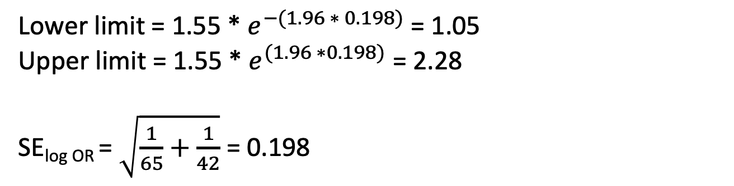
95% confidence interval (CI) for odds ratio (OR) in matched case-control study
 | Atherosclerosis - / CMV + | Atherosclerosis - / CMV -
Atherosclerosis + / CMV + | 214 | 65
Atherosclerosis + / CMV - | 42 | 19
Lower limit = 1.55 * $e^{−(1.96 ∗ 0.198)}$ = 1.05
Upper limit = 1.55 * $e^{(1.96 ∗0.198)}$ = 2.28
SE_{log OR} = $\sqrt{\frac{1}{65}+\frac{1}{42}}$ = 0.198
Source: Szklo, Moyses, Nieto, F. Javier. Epidemiology. Jones & Bartlett Learning.
Notes:
And, we can calculate the 95% confidence interval similarly to the way we did so with the unmatched data.

Slide 25
McNemar’s chi-square test for matched case-control study
 | Control / Exposure + | Control / Exposure -
Case / Exposure + | a | b
Case / Exposure - | c | d
$$X^{2}= \frac{{(\left|b −c\right|−1)}^{2}}{b+c}$$
Notes:
Finally, we can test the null hypothesis that that the matched OR = 1.

Slide 26

McNemar’s chi-square test for matched case-control study
 | Control / Exposure + | Control / Exposure -
Case / Exposure + | 214 | 65
Case / Exposure - | 42 | 19
$X^{2}= \frac{{(\left|65 −42\right|−1)}^{2}}{65+42}$ = 4.52
p-value = 0.033
Source: Szklo, Moyses, Nieto, F. Javier. Epidemiology. Jones & Bartlett Learning.

Slide 27
Regression Analyses for Case Control Studies
Unmatched
Logistic regression predicting case/control status
Matched
Matching leads to non-independence in the matched pairs
Must be accounted for in analyses
Inflated type-1 error rate
Conditional logistic regression
Case-cohort
Overlapping cases and controls in subcohort
Cox model allows for staggered entries

